Slide 1

Board Game Geek
Ranking Analysis from 1 November 2022
Nick Kempe

Slide 2
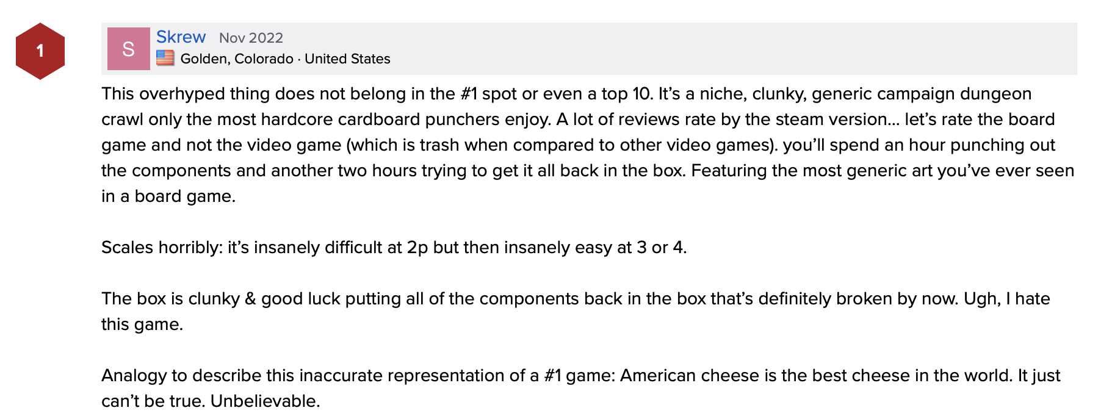
What makes a board game great? *according to BGG users

Slide 3

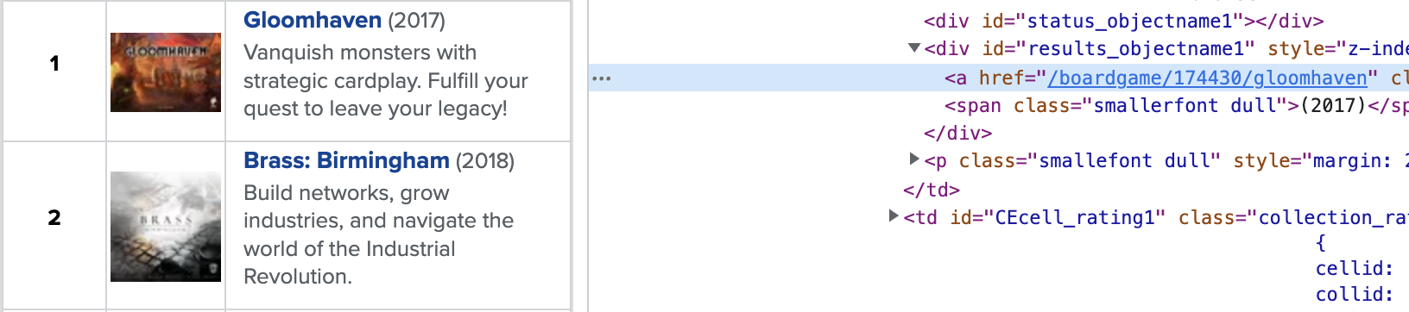
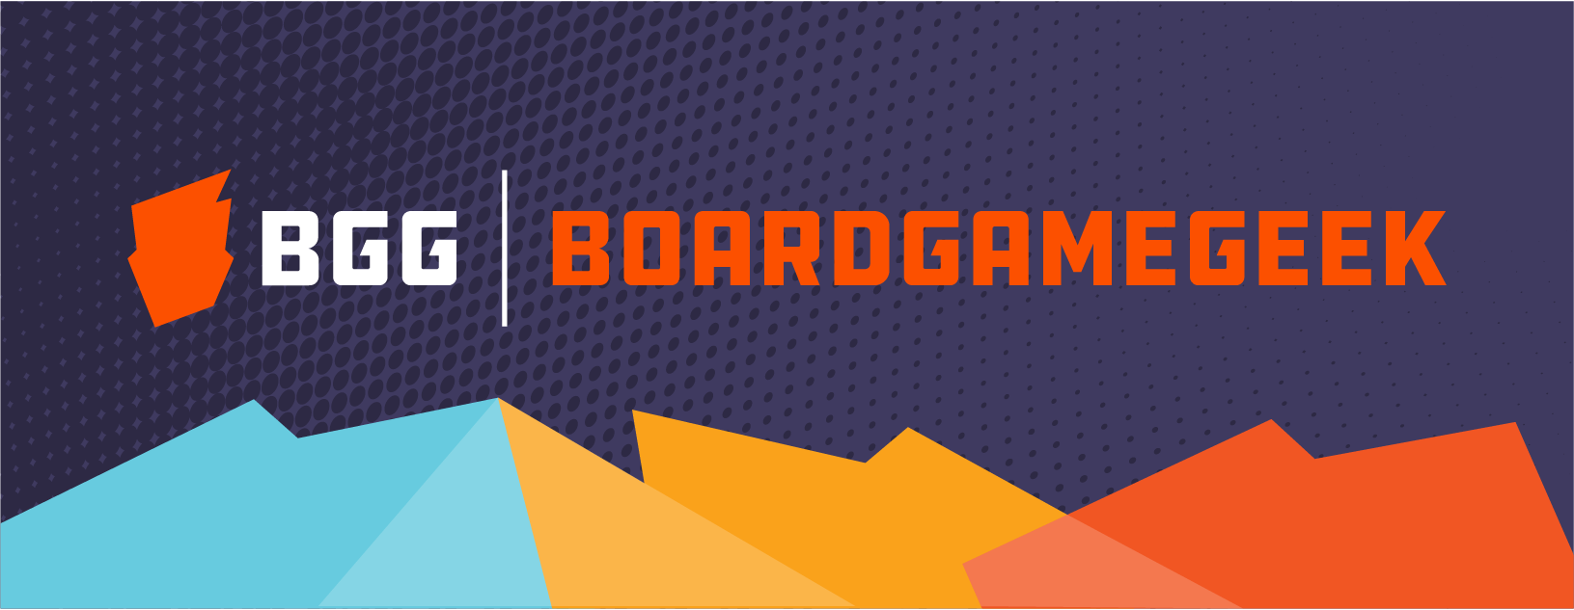
Data Collection: The BGG List

Slide 4
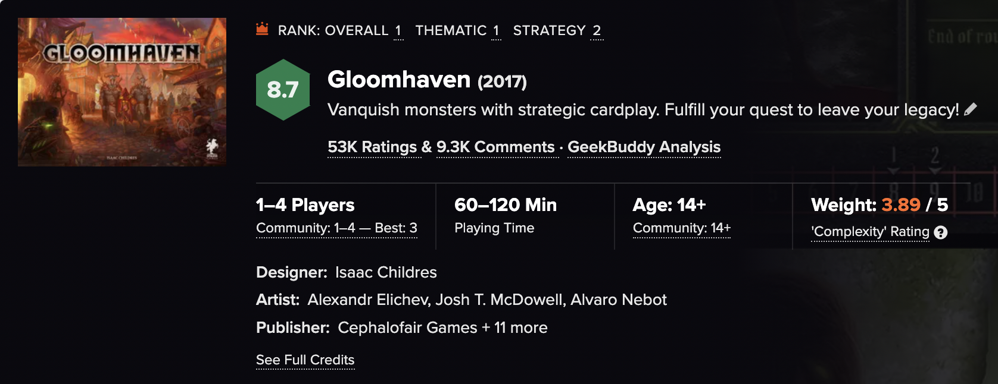
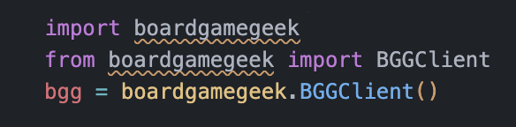
Data Collection: The BGG API

Slide 5
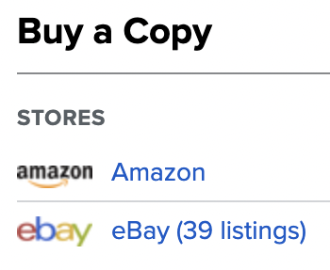
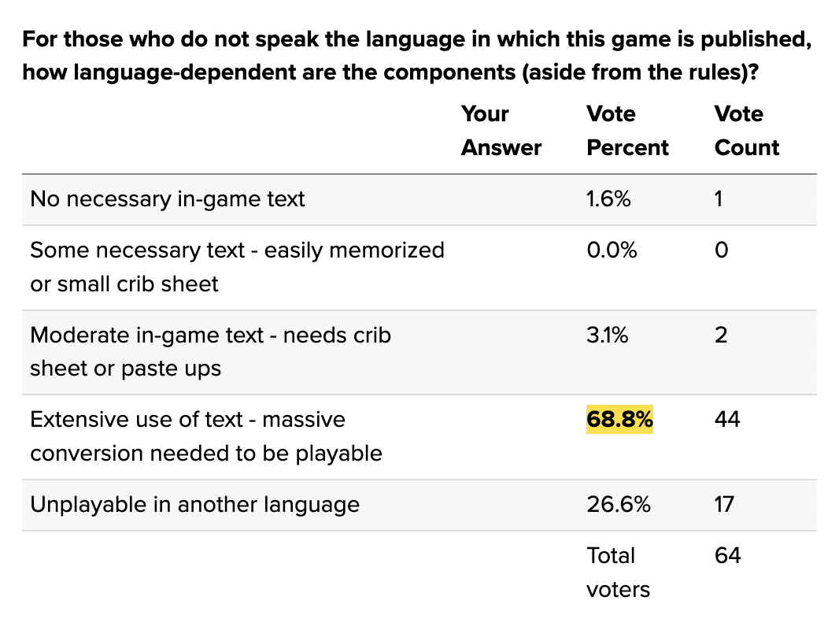
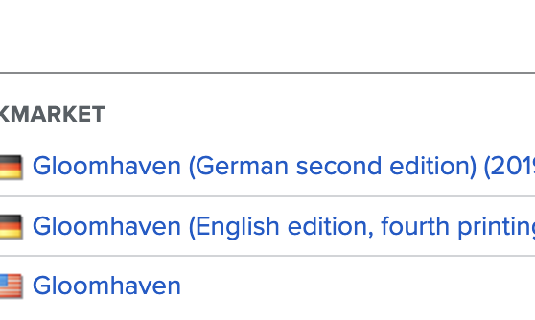
Data Collection: The Money Shot

Slide 6
Data Analisis: My hypotheses
#1 Heavy games will be higher ranked.
#2 Category representation not linked to sales.
BGG: "almost all users prefer modern games that exhibit advancements in game play and component quality since Monopoly was first published."

Slide 7
Data Analisis: Was BGG right? Was I right?

Slide 8
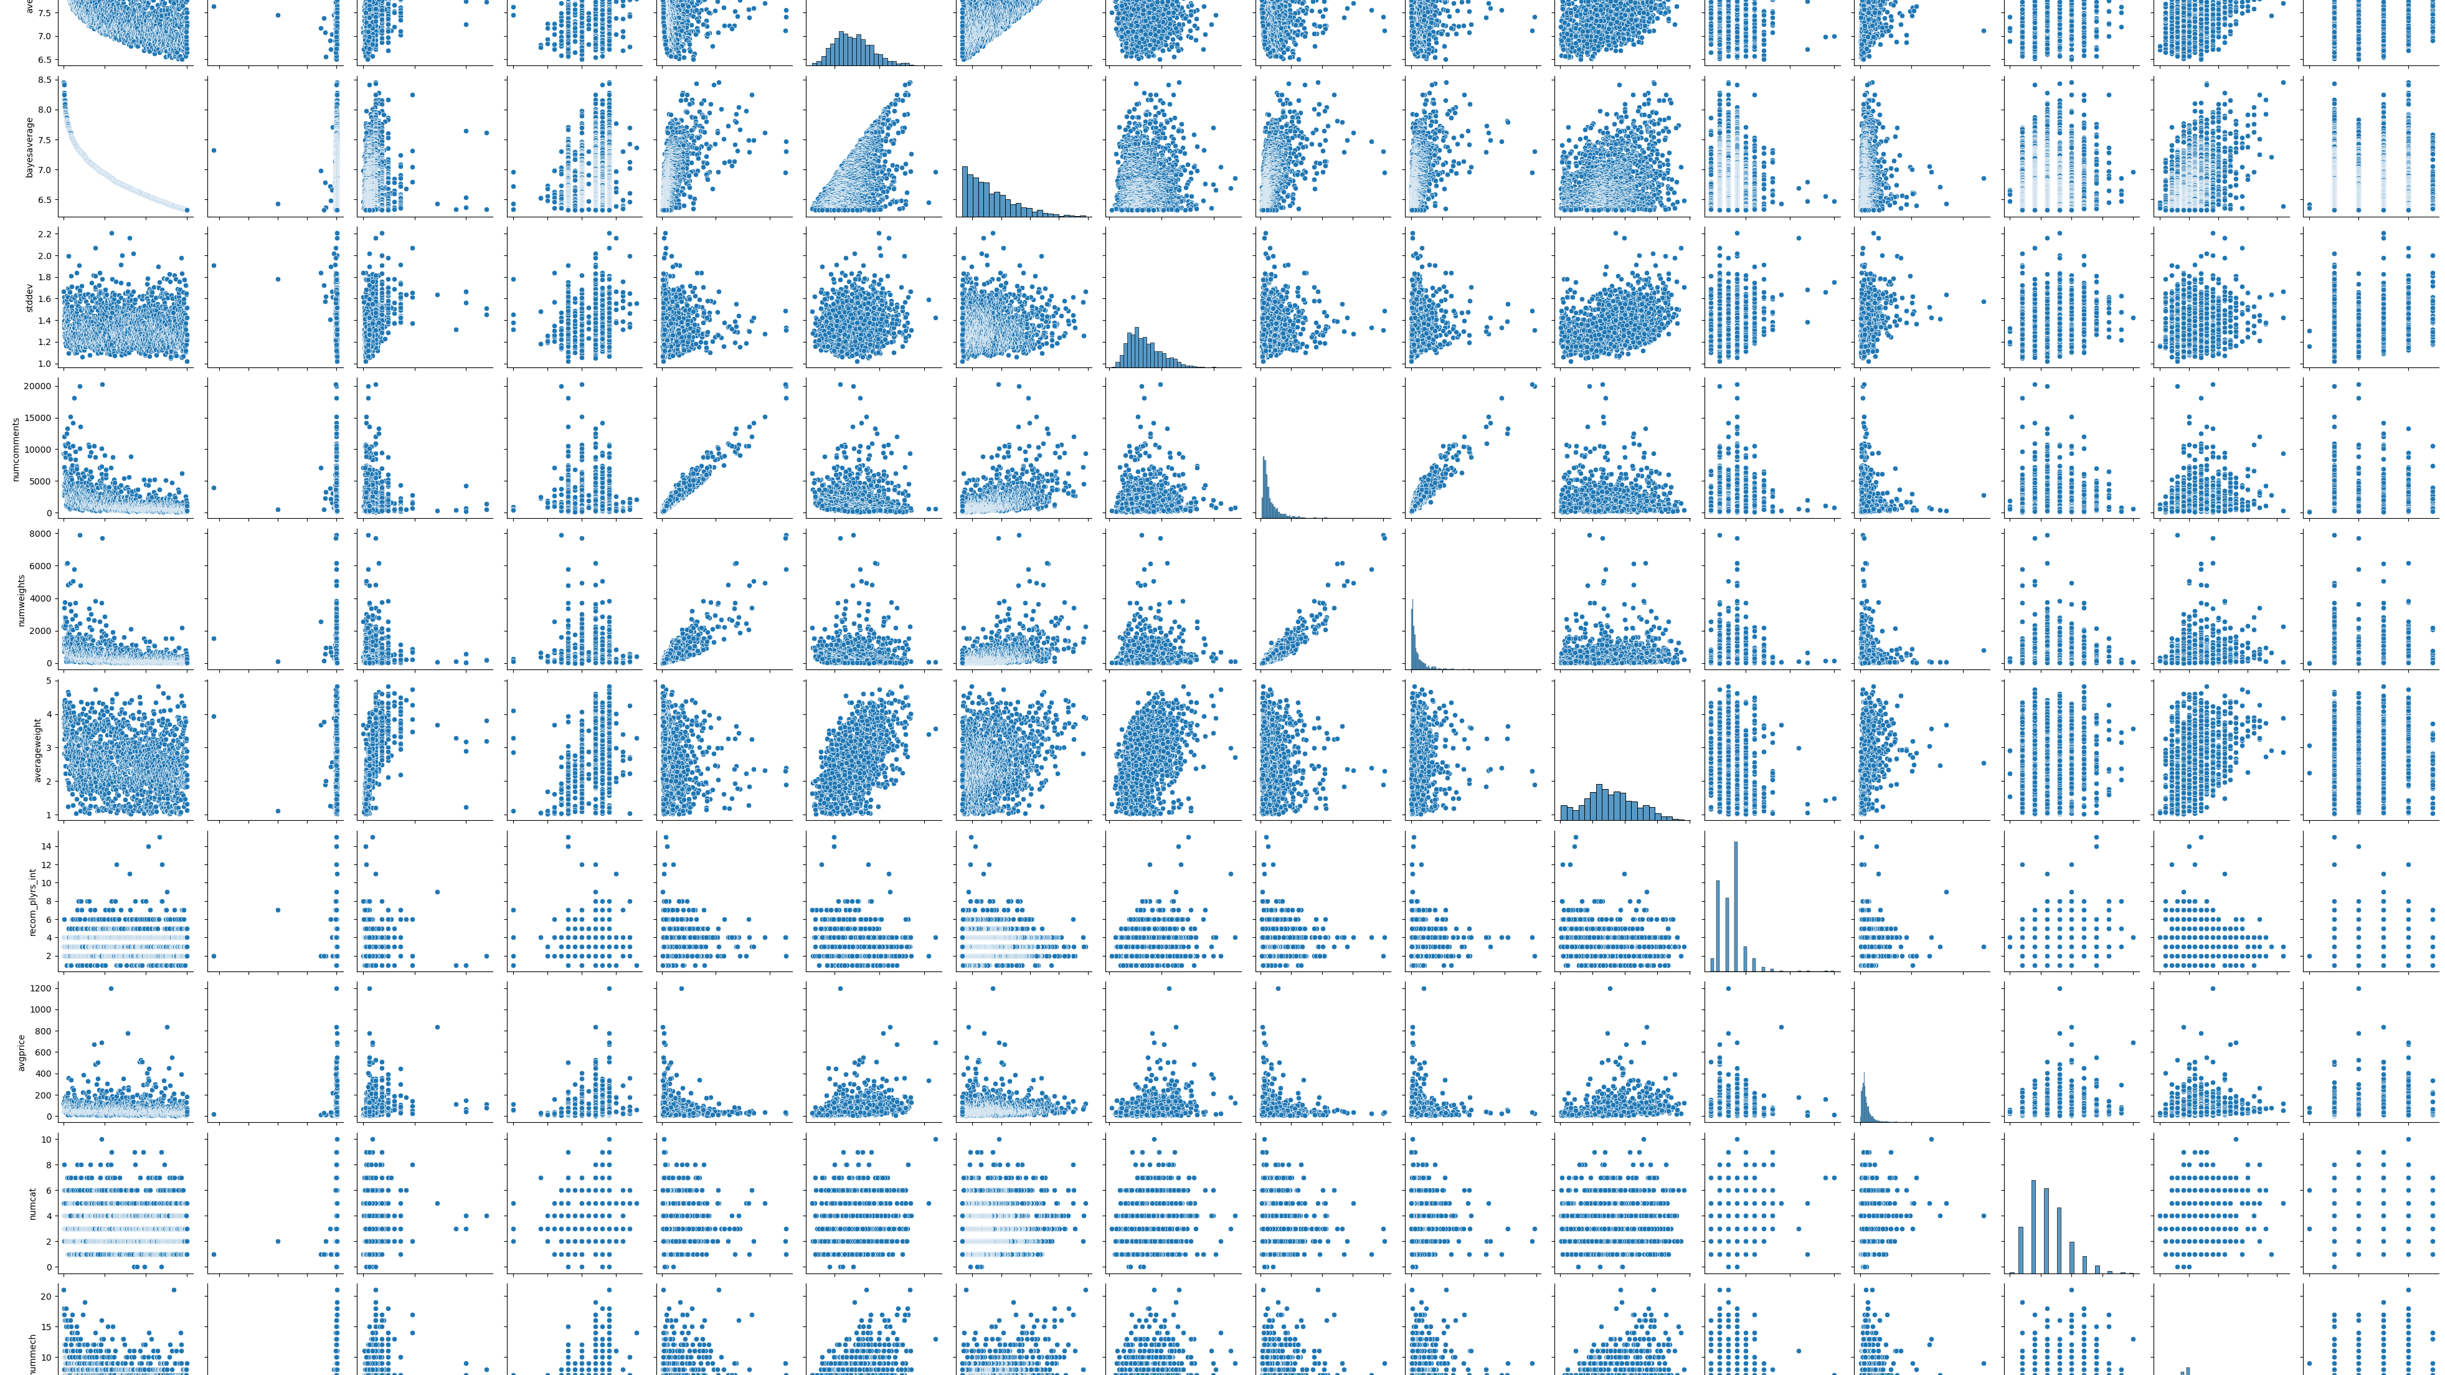
Not really

Slide 9
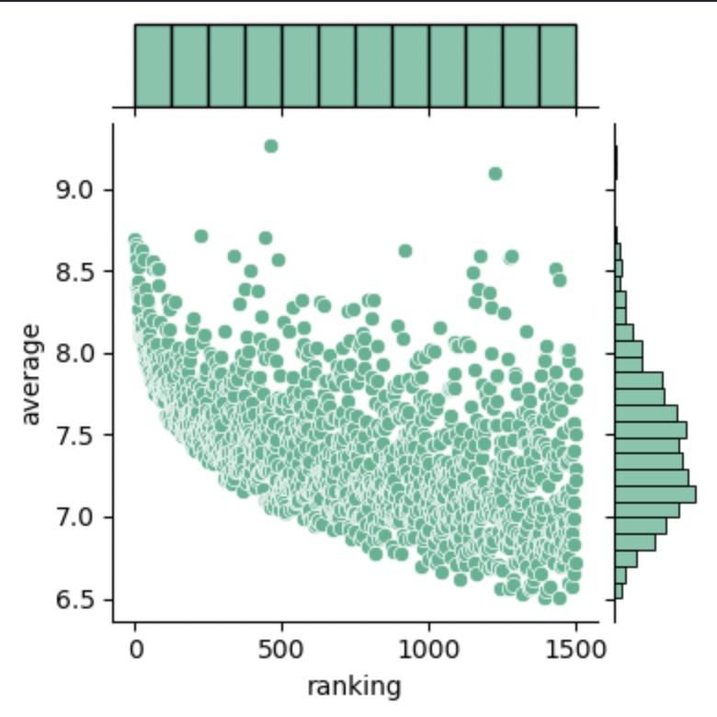
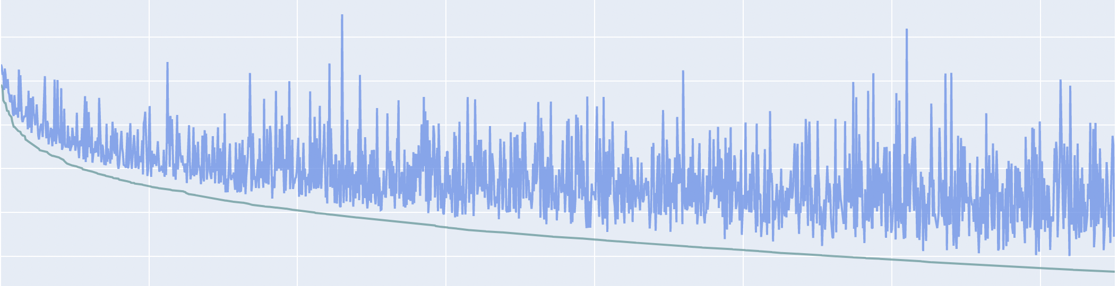
Popular games are popular

Slide 10
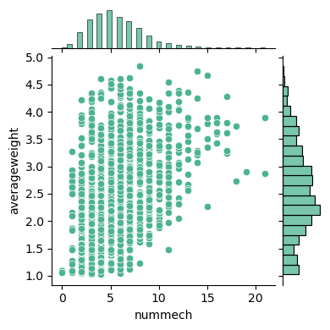
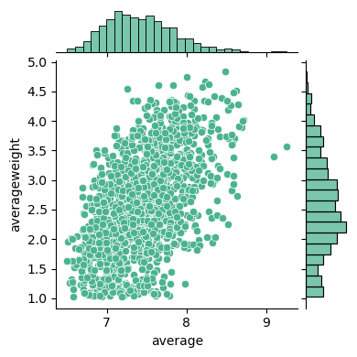
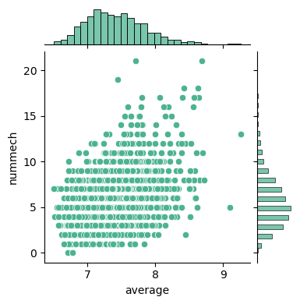
#1 The heavier the better.
"I wan´ em real thick an´ juicy."
-Sir Mix-a-Lot

Slide 11
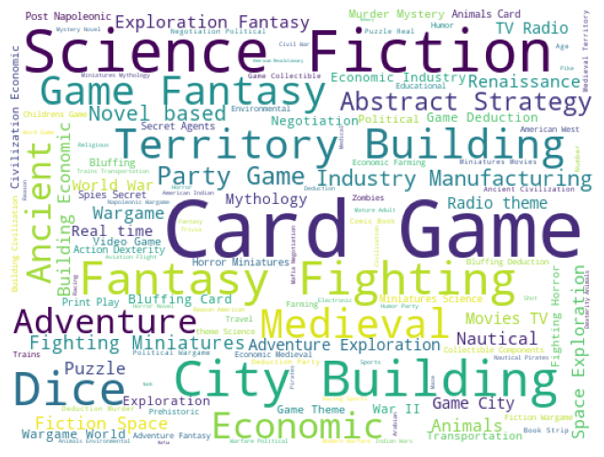

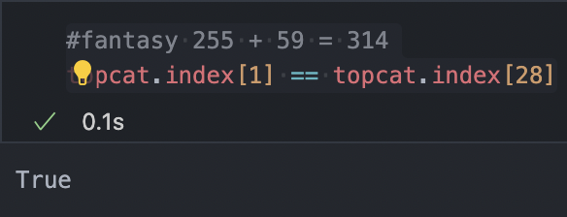
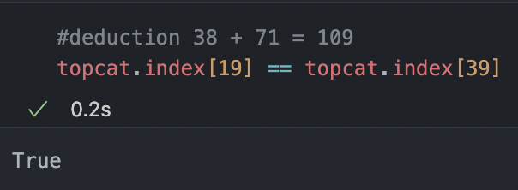
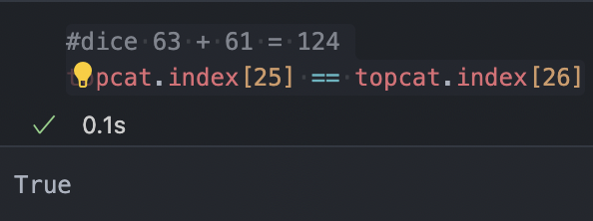
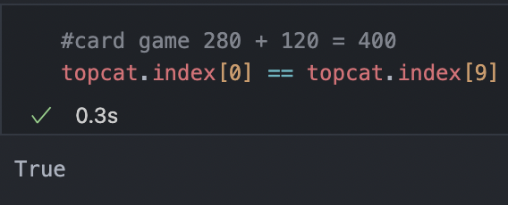
#2 Category representation not linked to sales.
This analysis will be delivered in a future sprint.

Slide 12
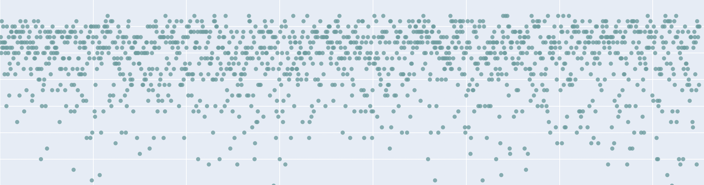
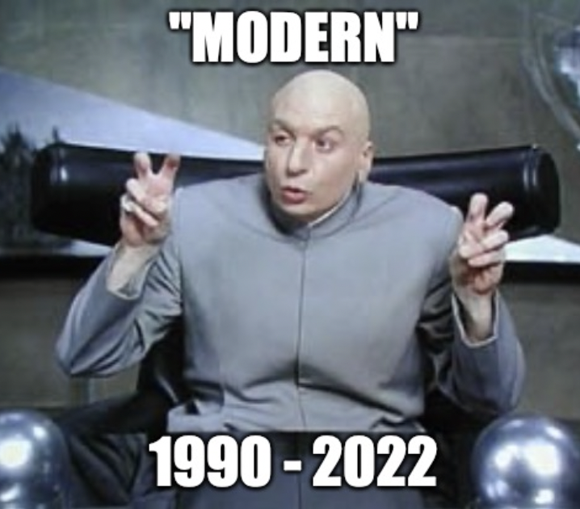
BGG: "almost all users prefer modern games..."

Slide 13
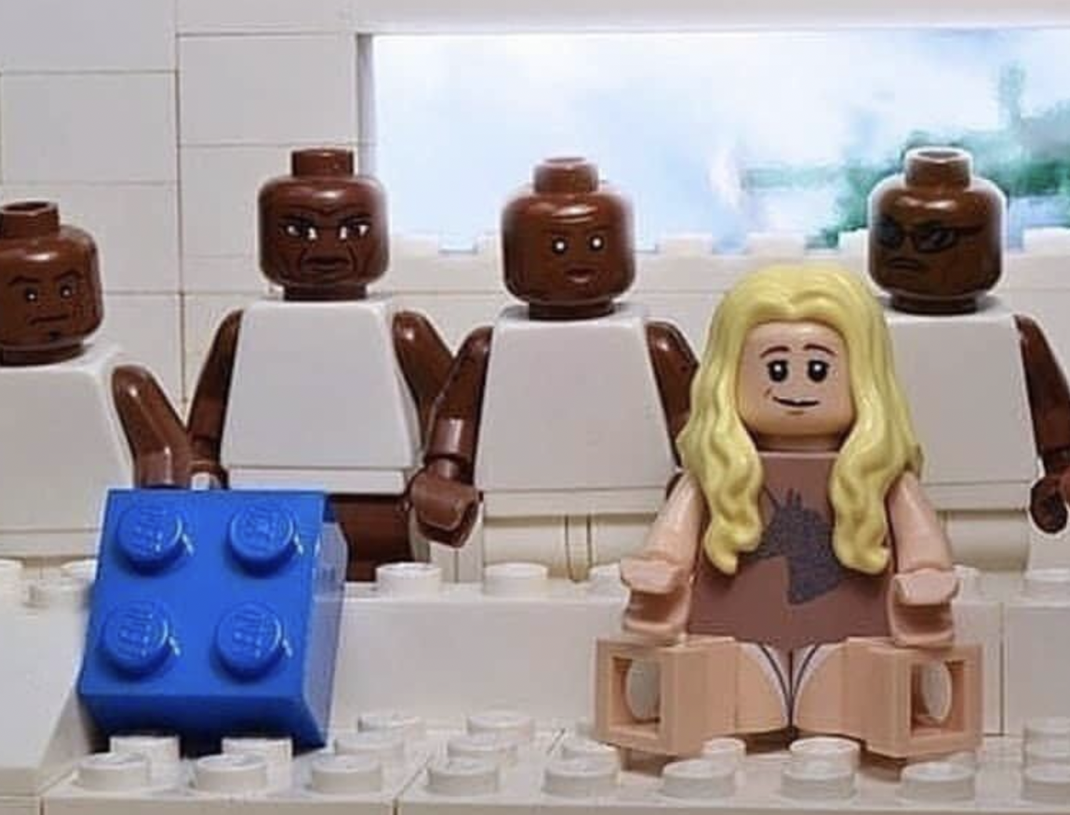

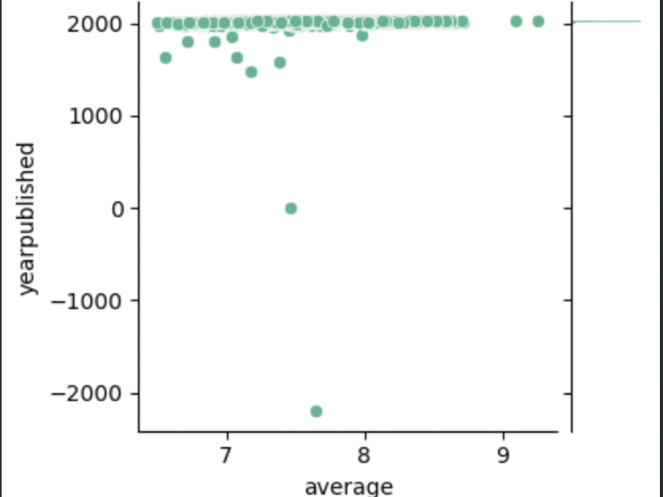
Outliers?
One story has it that Go was invented by the legendary Emperor Yao (ruled 2357-2256 BC) as an amusement for his idiot son.

Slide 14
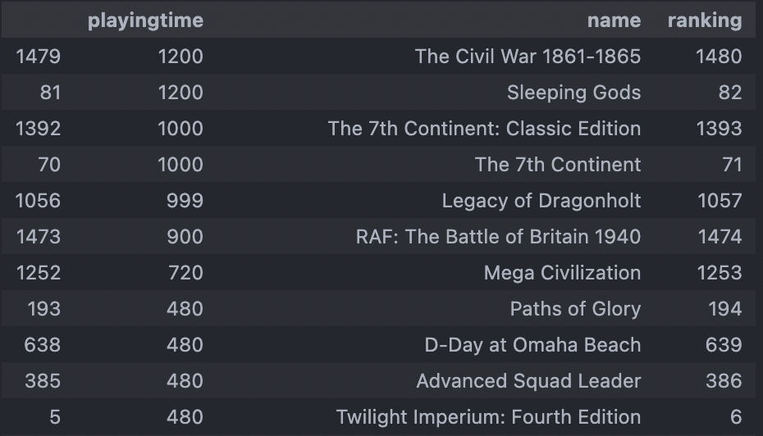
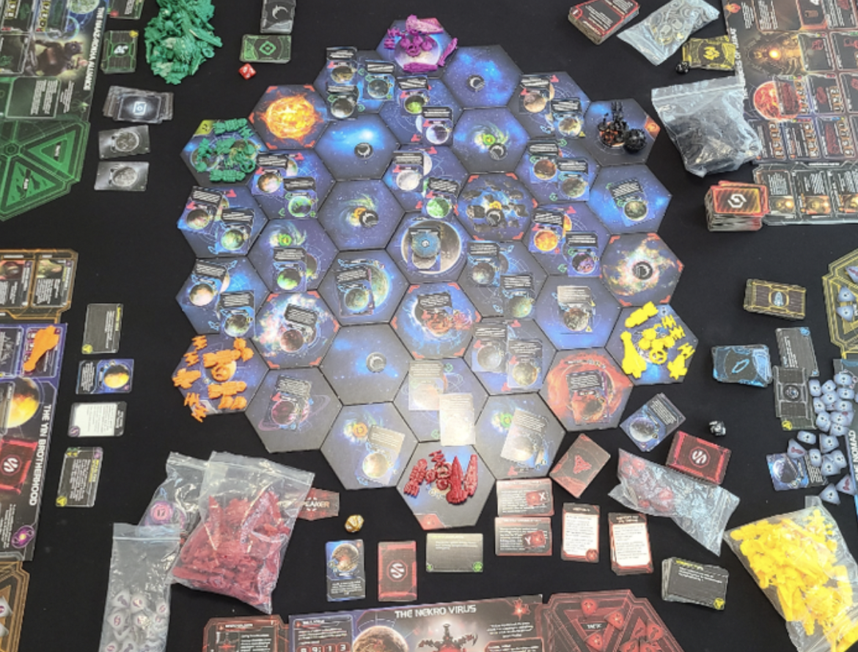
Outliers?
An excellent game - I need to check out this online gaming option to address the problem of how long it takes to play combined with how big it is to leave set up for the weeks it takes to finish.
-Nick West bgg.com/6833/user-review

Slide 15

What did I learn?

